Slide 1
Meet the Teachers
LKS2
2023-2024

Slide 2

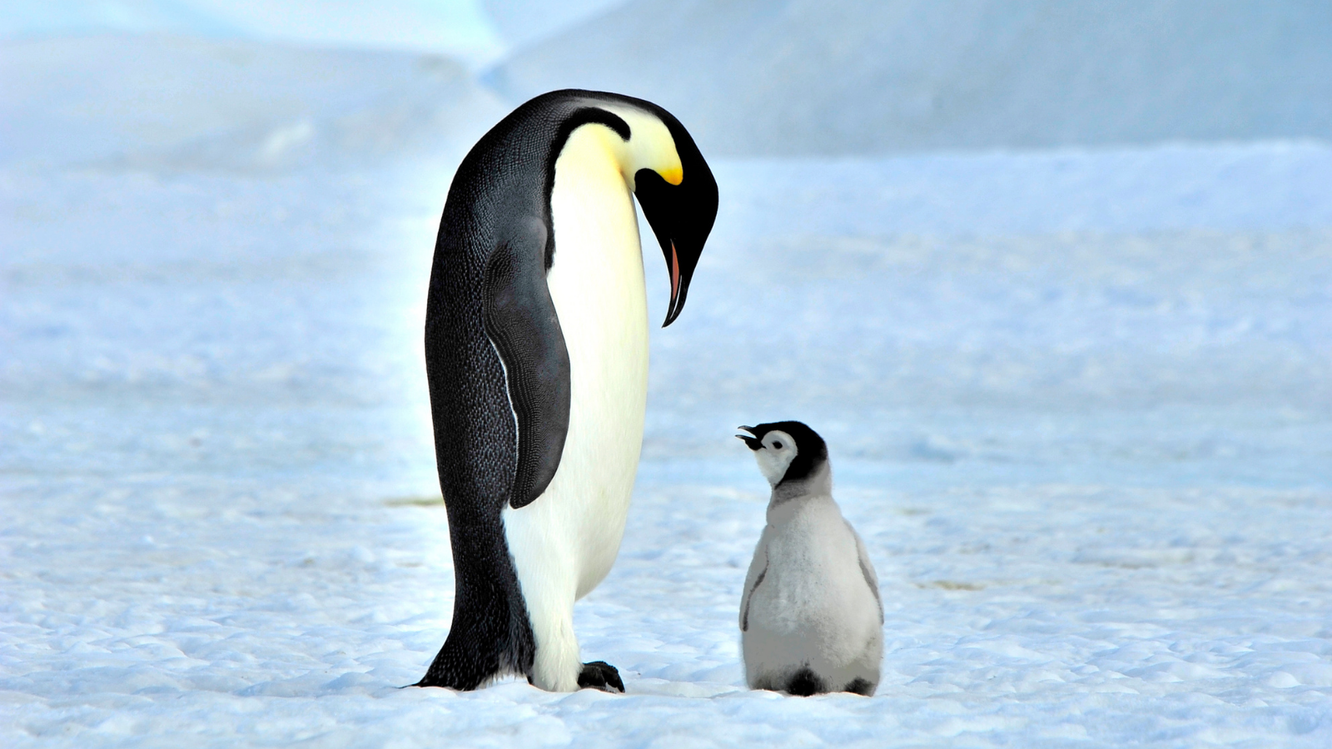
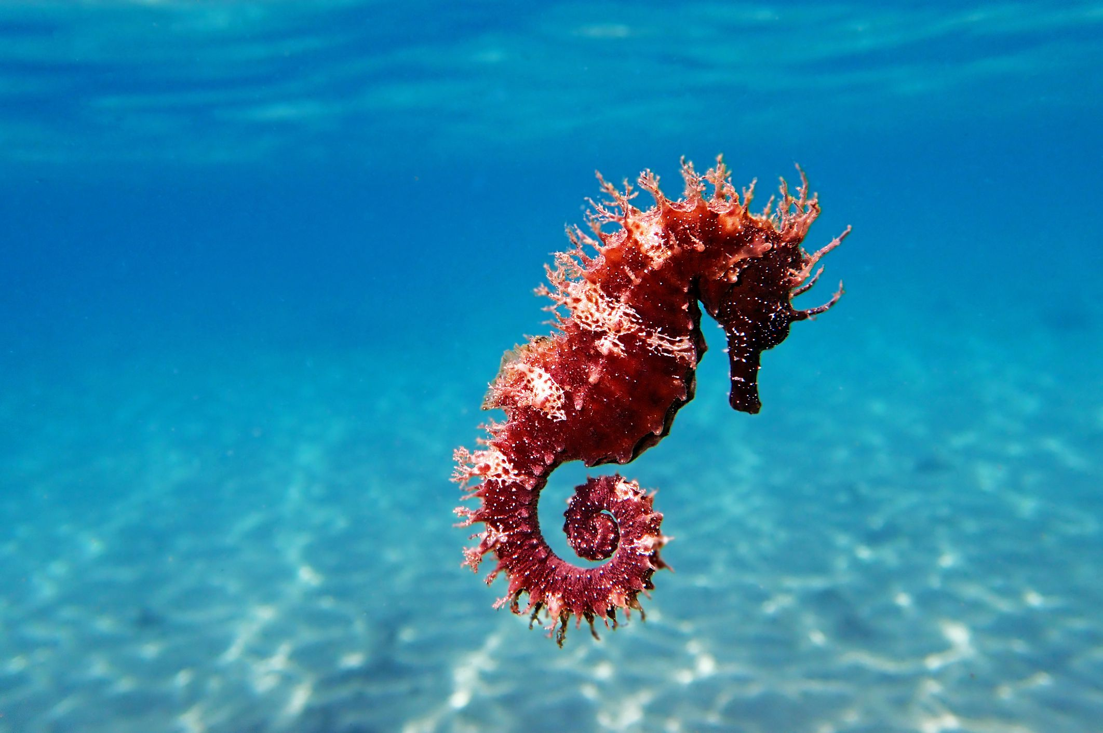

Who’s who in Year 3/4?
 | Turtle Class | Penguin Class | Seahorse Class | Phoenix Class
Teachers: | Miss Ragon/Mrs George | Miss Baker /Mrs George | Mrs Kay | Mrs Bonner
Teaching Assistants: | Miss Yates/Mrs Holmes | Mrs Swinden | Mrs Sawyer | Mrs Ingram Miss Landsdale Miss Lee/ Miss Dalton
HLTA: | Mrs Williams

Slide 3

KS2 nurture provision - Phoenix Class
As a Nurturing School, Langafel uses Thrive Approach and Nurture UK Principles to enable all children to develop socially and emotionally throughout all learning. Phoenix class builds on these principles in a more relaxed setting with a smaller group of children. A number of children in LKS2 will have Phoenix class as their class base; from there they will access mainstream learning. Other children may have a mainstream class base but access Phoenix class for specific learning opportunities and/or social skills and well-being interventions throughout the week.
Phoenix class, led by Mrs. Bonner has adopted the following Nurture Principles:
1. Children’s learning is understood developmentally.
2. The classroom offers a safe base.
3. Nurture approaches aid the development of self-esteem.
4. Language is adapted to ensure children can follow the curriculum.
5. Positive behaviour support facilitates self-regulation.
6. Transitions are significant in the lives of children and may require additional provision.
Mrs Bonner works closely with the class teachers, AEN team and Senior Leadership team to ensure access is fair and appropriate for the individual child. Decisions about class bases are made by staff only, each group is looked at closely with careful consideration of individual needs.

Slide 4
Classrooms and Entering/Exiting School
Arrive between 8:30-8:40am – Use the drive-in system to drop your child off in the back playground or walk in by foot. Children come into school via the Year R outdoor area (next to Molly’s)
School ends at 3:10 pm – Please avoid arriving early as this can cause traffic on Gorsewood Road.
Collect your child from the same gate as morning drop off by foot or by using the drive-in system to collect your child in the same way as KS1.
If you are running particularly late, please inform the office. The pick up window is 3:10 -3:20pm.
Children attending after school club are sent directly there from their classroom at the end of the day.
Children attending teacher-led clubs are sent to the location of the club/the classroom of the teacher running the club.

Slide 5
A Typical Day in Year 3/4
Time | Session
8:30am – 8:55 am | EMW and registration
8:55 am – 10am | English
10am – 10:30am | Guided Reading /phonics / SPAG
10:30am – 10:50am | Worship
10:50am – 11:05am | Break
11:05am – 12:10pm | Maths
12:10pm – 1:10pm | Lunch
1:10pm – 2pm 2pm – 2:55pm | Two sessions: Topic, PE, Science, RE, Computing, French, RSHE
2:55pm – 3:10 pm | Story time and Home
Children that still require phonics learning will do this along with appropriate guided reading instead of SPAG until they are ready.
Year groups are split for maths – two Year 3 classes and two Year 4 classes

Slide 6
Other curriculum areas
The Year 3/4 curriculum map which shows the national curriculum progression throughout the year will be available on the school website from September.
https://www.langafel.kent.sch.uk/academics
Knowledge Organisers for every new topic can be found on the school website and a paper copy will be provided.
https://www.langafel.kent.sch.uk/blank-page-8

Slide 7
Curriculum map
 | RE | Geography/History | Science
Term 1 | People of God | Rivers | Living things
Term 2 | Sikhism | The Romans | States of Matter
Term 3 | Incarnation | Coasts | Sound
Term 4 | Salvation | Local History (Roman) | Electricity
Term 5 | Kingdom of God | The Americas | Habitats
Term 6 | Sikhism (celebrations) | Crime and Punishment | Digestive System

Slide 8

Core curriculum: Reading in LKS2
Reading for Pleasure
In KS2 children will use the Accelerated Reader reading platform
Accelerated Reader is a programme which is designed to do the following things:
Find books that are the right ability for your child
Encourage your child to read more
Improve your child’s reading ability.

Slide 9

How it works…
At the start of the year every child takes a Star Reading Test, which is a computer-based test that measures a student’s reading ability through a series of 34 questions.
Every test for every student is different, and the computer selects different questions for each student dependent on how well they answer the previous questions. Essentially, the computer adapts the test to suit your son or daughter.
Once completed, they are then given a reading age and a ZPD score.

Slide 10

ZPD is two numbers that the student uses to choose their next reading book.
The lowest number is the lowest level of book the student should be choosing.
The highest number is the highest level of book the student should be choosing.
Students keep a record of all their ZPDs in their reading records.
Your children will be assessed using Star Reader 4 times a year : in September,December,March and June; so students can see improvements in their reading ability, but also choose more challenging books.
3.2 – 4.6
Lowest number
Highest number

Slide 11

AR Quizzes
A quiz is different to a STAR test because students only take a quiz after they have finished a book.
There are usually about 10 questions on the book that has been read. At the end of the quiz the students are given a percentage to show them how well they have done.
There are some important rules for taking quizzes:
The book the child is quizzed on must be a book they have just finished reading.AR is not a memory test but rather measuring reading ability.
A student cannot take a quiz until they have read the entire book.
Quizzes must be done individually, not with anyone’s help.

Slide 12

“How much should my child read each day?”
“How can I help?”
According to Renaissance Learning’s research, children who read at least 20 minutes a day with a 90% comprehension rate on AR quizzes see the greatest gains.
As with anything, performance improves with practice.
      Encourage your child to read at home.
Create a culture of reading in your household by reading with your child, starting a home library, visiting your local library, charity shop or bookshop on a regular basis and by letting your child see you reading.
Therefore, your child should have at least 20 minutes set aside for reading during each day.
Teachers set reading homework on top of the other English homework they set.
When reading with your child stop and ask questions to be sure your child comprehends what they have read and in general make a habit of discussing books that each of you has read.

Slide 13
Core curriculum: Reading in LKS2
READING | Year 3 and Year 4
How are reading books organised and changed? | Children hand in their reading book and contact book every day which is checked daily. The majority of children will access a reading book from the Accelerated Reader levelling system, however, if you child still requires phonics, they will continue on the Little Wandle (Collins Big Cat) level books.
How is reading taught in school? | Little Wandle Phonics Programme for those still requiring phonics Daily guided reading sessions Daily independent reading and class story time
Expectation for reading to an adult at home. | Children are expected to read at least three times a week to an adult at home which is logged in their contact book.
What else can I do to support my child? | Reading to your child/sharing a book for pleasure and talking about what has happened/is happening in the book; make predictions; discuss what they liked/disliked and why etc. Audio books Expose them to a range of texts – fiction as well as non-fiction.

Slide 14
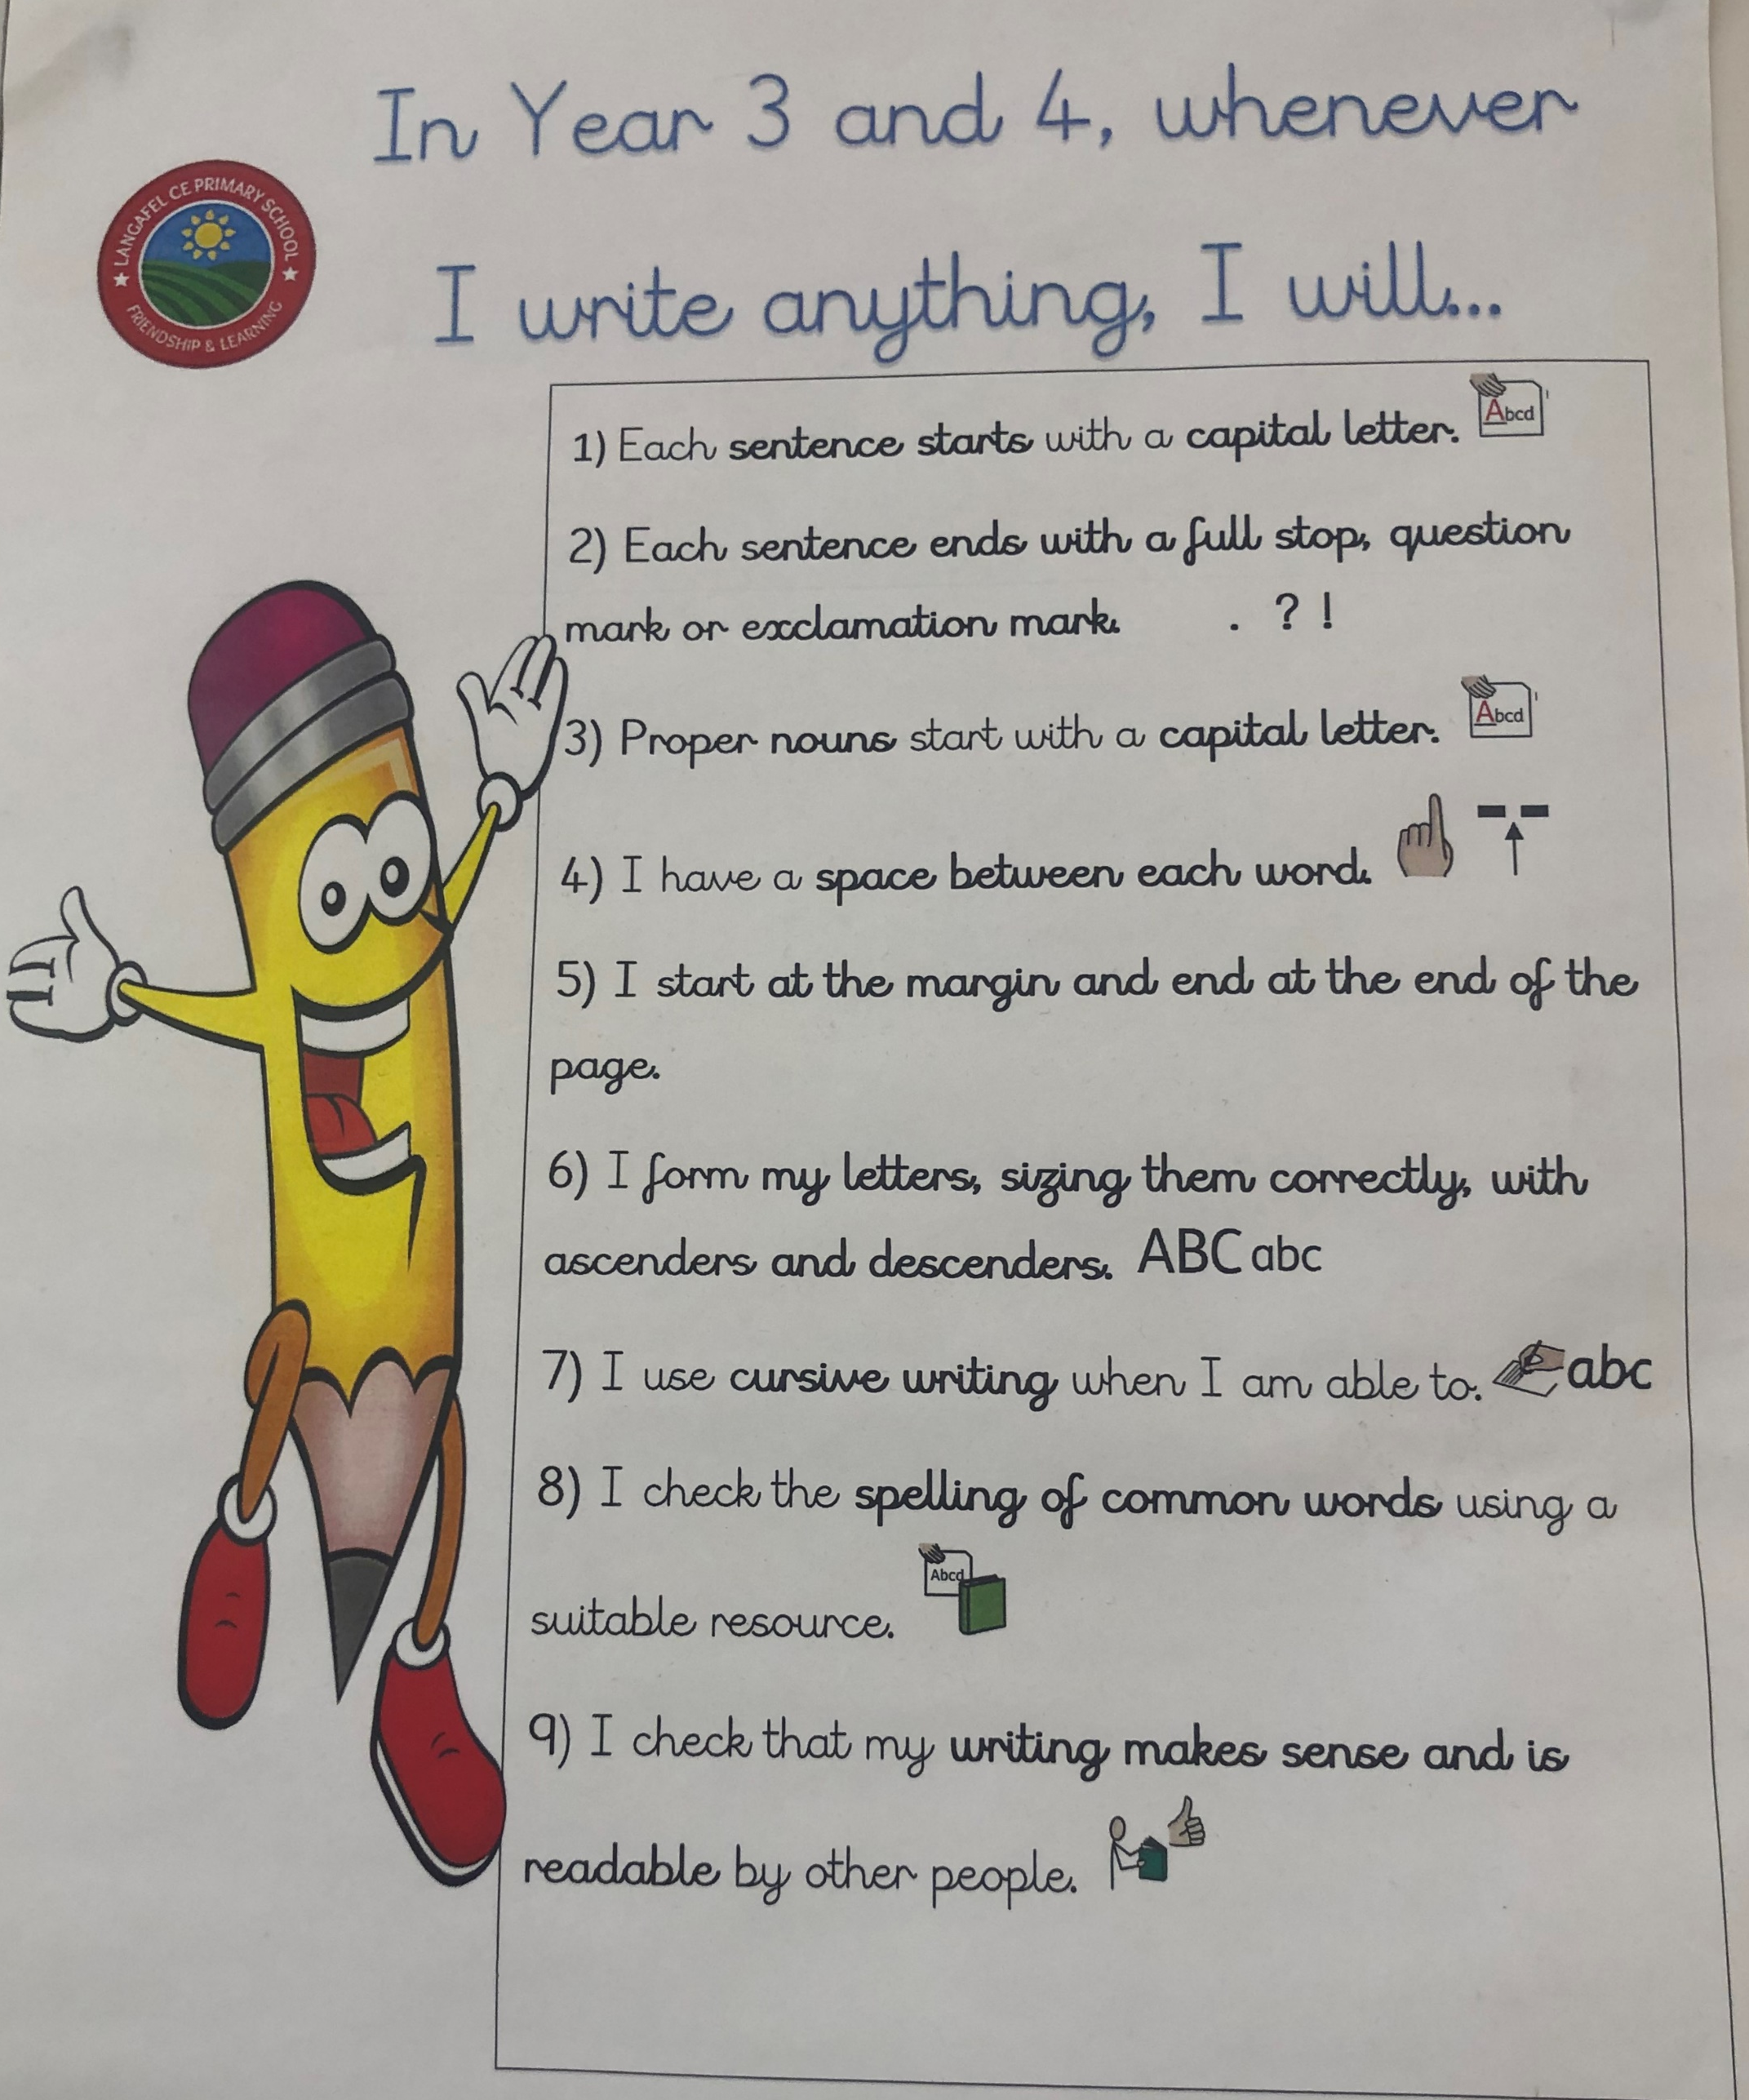
Core curriculum: Writing in LKS2
How is writing taught in school? | The non-negotiables in Year 3/4
We use The Write Stuff scheme an try to select units from this which fit in with topics being taught in the wider curriculum, although this is not always the case. The Write Stuff incorporates grammar, punctuation and spelling into writing lessons and teaches children how to write across different genres of writing whilst integrating their specific features.
Capital letters and correct punctuation in sentences.
Capital letters for proper nouns.
Space between every word.
Starting at the margin and writing across the page.
Letter formation is correction for lower and uppercase letters.
Cursive writing is used.
Spelling of common words is checked and correct.
Checking your writing makes sense.

Slide 15

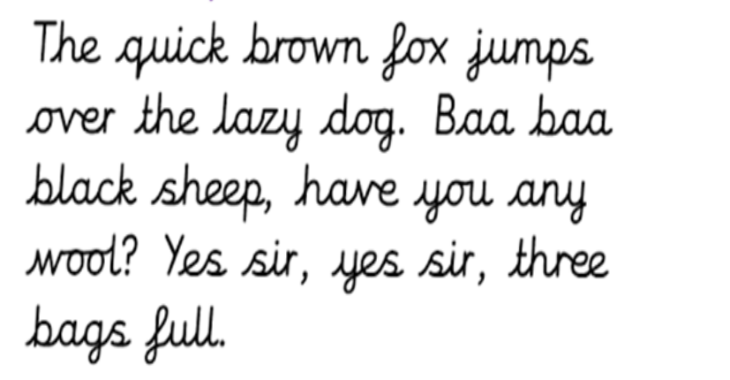
Core curriculum: Writing in LKS2
HANDWRITING | Year 3 and Year 4
All Year 3 and 4 children are expected to do joined up writing – this is part of the expected standard. | There will be a big focus on handwriting at the start of the year to improve joined up writing as well as size/proportions. Descenders must go under the line (f g j p q y)

Slide 16
Core curriculum: Maths in LKS2
Maths | Year 3 | Year 4
Teaching of maths | Two mixed ability year group class.
Times Tables | Children will know the 2, 3, 5 and 10 times tables from Year 2. In Year 3, they will learn the 4, 8 and 11 times tables and how to count in multiples of 50 and 100. | Continue to revise the 2, 3, 4, 5, 8 and 10 times tables. In Year 4, children will learn the 6, 7, 9 and 12 times tables and how to count in multiples of 25 and 1000.
 | Times Table Rockstars will be rolled out across the phase.
Key facts that they need to know | Recognise the place value of each digit in a three-digit number (hundreds, tens, ones) Compare and order numbers up to 1000 Addition and subtraction up to three digits using the column method | Count backwards through zero to include negative numbers Recognise the place value of each digit in a four-digit number (thousands, hundreds, tens, and ones) Order and compare numbers beyond 1000 Round any number to the nearest 10, 100 or 1000 Addition and subtraction up to four digits using the column method

Slide 17


All children in LKS2 will be issued with a Times Table Rockstars login.
Times Table Rockstars is an award winning maths programme with a rockstar theme, designed by maths teachers to help children learn their times tables.
The children can use the platform both at school and home.

Slide 18
Other significant dates/events
Year 4 Multiplication Test
All Year 4 children complete the test
The test takes place during term 6 (beginning/mid June)
The test’s purpose is to see if children can fluently recall tables up to 12.
What the test involves:
Judges children’s ability to recall 25 times table facts.
They are given 6 seconds to answer each question (the test should take no longer than 5 minutes)
For more information on the multiplication tables check: https://www.gov.uk/government/publications/multiplication-tables-check-information-for-parents/multiplication-tables-check-information-for-parents-text-version--2

Slide 19
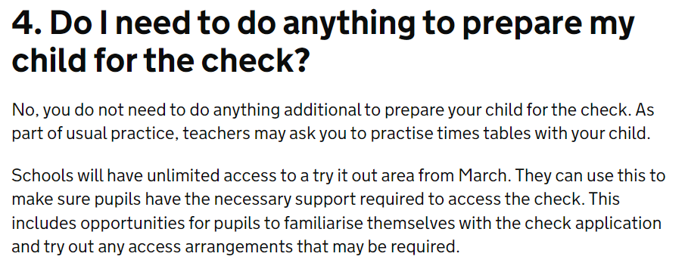
Year 4 Multiplication Tables Check info
Supporting your child:
Regular times tables practise!
For more information on the multiplication tables check: https://www.gov.uk/government/publications/multiplication-tables-check-information-for-parents/multiplication-tables-check-information-for-parents-text-version--2

Slide 20
PE
 | Turtle,Penguin and Seahorse
PE | All classes will have another PE session during the week – days to be confirmed at the start of Term 1.
Swimming | Each class will swim on a different day of the week in term 1, 5 and 6. (Info on next slide)
Mandatory PE kit:
Black plimsolls/sensible trainers
Plain black shorts
T-shirt in house colour – house colour PE tops with the school logo on are available to purchase on the uniform website or a plain shop brought one is acceptable; this means no logos or brands written across the t-shirt.
PE is not a fashion show - own clothes and football kits are not PE clothing.
If your child wears clothes that are not within the PE kit uniform policy, you will be phoned and asked to bring in appropriate PE clothing.
All jewellery removed – children have to remove their own earrings (no tape allowed)
Optional Extras
• Plain black tracksuit (optional for outdoor PE sessions in cold weather)
• Plain black zip-up jacket

Slide 21
Swimming in Yr 3/4
Year 3 and 4 swim in Term 1, 5 and 6
Each class will swim on a different day. This counts as one of their weekly PE sessions in term 1, 5 and 6. The class are split into two groups based on their ability/confidence in the water. This means roughly 15 children are swimming at one time.
Lessons are taught by an outside agency who are supported by our own staff.
If children are unable to swim due to illness they will require a note from home.
Swimming kit:
• Swimming costume/trunks (no bikinis allowed)
Towel
Swimming cap – children with hair shoulder length or longer must have it tied up with a cap on)
All jewellery removed – children have to remove their own earrings
Goggles are optional

Slide 22
Homework expectations in LKS2
Year 3 and Year 4
Daily reading (at least three times a week) Weekly homework – handed out on a Friday and due the following Wednesday – this will be maths and SPAG (spelling, punctuation and grammar) /reading comprehension activities linked to learning from the week. All children will also receive accessibility to Times Table Rockstars from home.
Rewards for homework House points will be given out for all completed homework.

Slide 23
Behaviour management – the positives!
Golden Book
Every week, a child in every class will receive the Golden Book Award in worship for something that has made them stand out, their efforts during a particular task or an individual achievement for the child.
Class marble jar
Each class will have a marble jar – they will earn marbles as a class for good behaviour, listening, working well etc. Once full, the class will get to decide on a class treat – extra green time, extra time outside etc.
House points
Each child will have their own house point tally. House points are given out for great work, manners, being helpful, participation etc. Children will receive a badge when they reach certain marks:
Bronze badge – 50 house points Silver badge – 75 house points
Gold badge- 100 house points Every 50 house points after 100 – prize from the class box (another prize will be given for every 25 house points after this)

Slide 24
Behaviour management
We believe that all children should enjoy the chance to develop their academic and social skills to the best of their ability in a friendly and positive environment. All children start on a green card. For behaviour that challenges and does not adhere to the class charter, children will go through the following procedure:
First act of behaviour – receive a verbal warning
Second incident – receive a yellow card – spend 10 minutes in the Reflection Room at break/lunch
Continuous behaviour/another incident – receive a red card – spend 15 minutes in the Reflection Room and behaviour documented on the school’s system.
Once they have been to the reflection room, their card will go back to green.
Depending on the severity of the incident, children can go straight to a red card without warning (example: maliciously hurting another child/adult, bad language, destruction to school equipment).
If behaviour continues/red cards are frequent, parents/guardians will be informed.
Our relational behaviour policy is updated yearly and can be found on the school website.

Slide 25
Attendance
Attendance is vital for children to learn. Missing learning can create gaps which a child struggles to fill. This can cause problems later on as learning builds.
Good attendance is anything above 96% (this equates 8 days of absence across a school year).
If absence is below 90% (20 days absence across the year) then your child is deemed to be persistently absent from education.
If your child is sick please contact the office with a reason on the 1st day of absence from 8:30am.
Attendance rewards
10 Days – Every day the whole class have 100% attendance, they progress towards the 10 goal. When they achieve 10 days of 100% attendance extra green time is given.

Slide 26
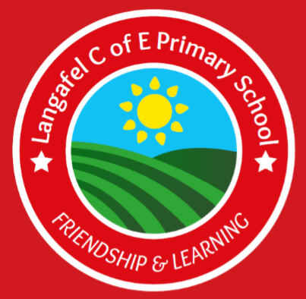
Uniform
Standard uniform
White polo, blouse or shirt
Grey trousers, shorts, skirt or pinafore
Red gingham summer dresses
Red jumper/cardigan with the school logo
Flat black shoes – no trainers
Plain black, grey or white ankle or knee length socks
Plain black, grey or red tights
Hair accessories – red, black or white and appropriate size
Hair longer than collar length should be tied back.
No make-up or nail vanish
No jewellery with the exception of 1 pair of small plain studded earrings, a small watch (not novelty) and jewellery worn specifically for religious reasons.

Slide 27
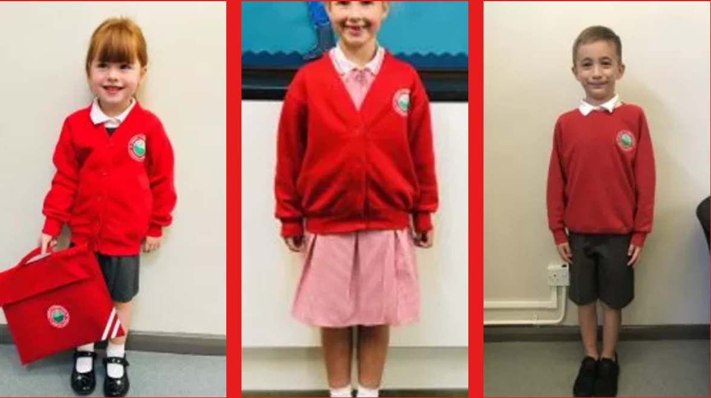
Uniform
Link to uniform on our school website:
https://www.langafel.kent.sch.uk/school-uniform
If your child does not have the correct school uniform, teachers will ask you when this will be provided and a more suitable school alternative may be given.

Slide 28
Food and Drink
Water in school - Children can bring in a water bottle to keep in the classroom; there is also access to a water fountain on the playground/drinking water to fill up bottles.
Playtime snacks - A snack of fruit or plain biscuits can be brought in for morning play time – fruit is no longer provided in KS2.
School Dinners - If your child requires a school dinner, this must be ordered and paid for in advance on CH&Co. School dinners are no longer free in KS2.
Packed Lunches - At Langafel we are committed to encouraging our pupils’ to eat healthily and make sensible food choices.
We encourage children to have a nutritious and balanced packed lunch – crisps and chocolate are allowed but in moderation and in addition to fruit and a healthy options.
No nut products; this includes chocolate spreads which may include nuts.

Slide 29
General Reminders
All required stationery is provided so pupils should not bring anything from home.
- This includes toys/fidgets, pencil cases, gel pens etc.
Pencil cases will be allowed on a Friday during Green Time or at the teacher’s discretion.
They need to have a good nights sleep, a healthy breakfast and be ready, willing and motivated to learn throughout the day.
They should be respectful to everyone they come in contact with, adults and children alike.
First Aid
Inhalers are to be given to the class teacher at the beginning of the year, these will be stored with your child’s details.
Unless there is a specific medical need which teachers have been informed of, pupils should not be going to the toilet during learning time and are encouraged to use the opportunity at break and lunch.

Slide 30
Parents in Partnership with School
Have a skill we could use? A job related to one of our topics? Talk to us!
Ways to keep in touch:
Message to adults on the gate in morning – these are all passed on to your child’s class teacher.
Brief chat at gate after school (teachers are busy getting children into cars so if you need a longer chat, please arrange a more convenient time with your child’s class teacher)
Email to book appointment: email addresses:
aragon@langafel.kent.sch.uk – Miss Ragon (Phase Leader and Turtle)
jbaker@langafel.kent.sch.uk – Miss Baker (Penguin)
skay@langafel.kent.sch.uk – Mrs Kay (Seahorse)
cbonner@langafel.kent.sch.uk – Mrs Bonner ( Phoenix)
If you do not receive school emails, please visit the office to check they have your correct/updated contact details.

Slide 31

Thank you for listening!
Any questions?

