Slide 1
Welcome to
KS1

Slide 2

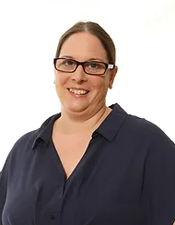
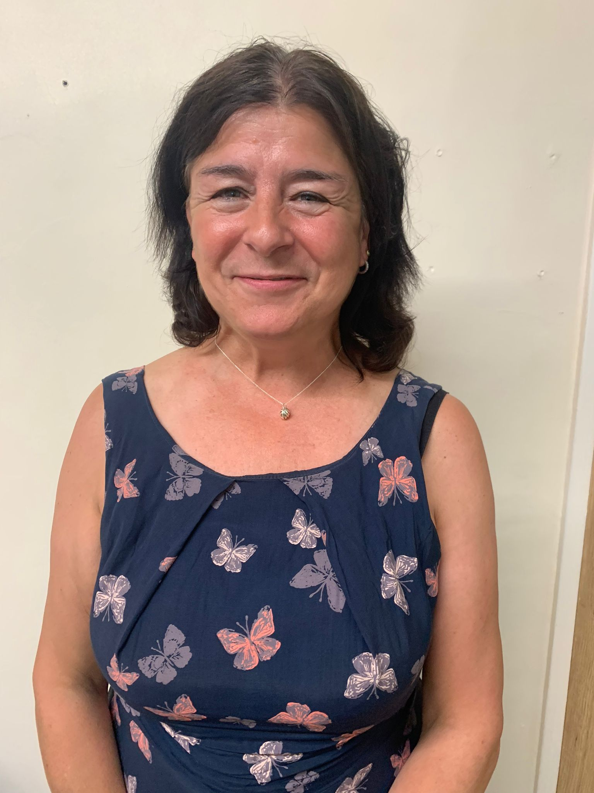

Key stage 1 team
 | Tiger Class | Koala Class | Wolf Class
Teachers: | Mrs Ellis | Mrs Watkins Mrs Keene | Mr Graham
HLTA: | Mrs Everson
Teaching Assistants: | Mrs King, Mrs Clark, Mrs Weekes

Slide 3
Classrooms and Entering/Exiting School
Come into school by the back playground (cars) or walking gate between 8.30-8.40am.
If late, please sign in at office.
School ends at 3:10pm.
Collect pupils from the back playground top gate or walking gate at 3:10pm, if you are driving please do not arrive early as it blocks up Gorsewood Road.
Children attending breakfast/after school club/s will walk there directly from their classroom.

Slide 4
Time/Day | Activity
8.30 | Early morning work and registration
8:50 | Handwriting
9:00 | Year 1 – Phonics Year 2 – SPaG Both – Guided Reading
9.35 | Maths
10.30 | Worship
10.50 | Break
11.05 | English
12.00 | Lunch
13.00 | Afternoon session input (Science, RE, Topic, RSHE) or PE Followed by child initiated learning
14:50 | Storytime
15:10 | Home

Slide 5
Continuous provision
What is Continuous Provision?
Continuous provision describes all of the different provision areas which are available for your children to use every day. Within each of these areas of provision there should be a core range of resources that children can use all of the time, throughout the whole year. Planning effectively for continuous provision is crucial and involves a consideration of classroom layout and resourcing that will enable staff to offer a breadth of learning possibilities.
Why is Continuous Provision Important?
Carefully planned continuous provision will enable children to learn skills, will challenge their thinking and help them to embed concepts. It should also provide the context for a variety of learning conversations between children and adults with rich opportunities for modelling and extending speech and vocabulary. It is within this learning environment that the children will also develop key learning attributes. How your environment is planned, resourced, valued and used can impact positively, or negatively, on children’s engagement, independence, collaboration, self-confidence, resilience and curiosity.

Slide 6
Homework expectations in KS1
Year 1 and Year 2
Daily reading (at least three times a week) Weekly homework – handed out on a Friday and due the following Wednesday – this will be either math's or SPAG (spelling, punctuation and grammar) activities linked to learning from the week. Current term curriculum homework – a selection of suggested activities related to the term’s topic will be in homework books at the beginning of a new term. The topic curriculum homework tasks are optional to complete but they will be a great opportunity for you to engage with your child and their learning around our current topic. Children will be given the opportunity to share any topic homework they complete with their peers.
Rewards for homework House points will be given out for all completed homework.

Slide 7
Uniform
Standard uniform
White polo, blouse or shirt
Grey trousers, shorts, skirt or pinafore
Red gingham summer dresses
Red jumper/cardigan with the school logo
Flat black shoes – no trainers
Plain black, grey or white ankle or knee length socks
Plain black, grey or red tights
Hair accessories – red, black or white and appropriate size
Hair longer than collar length should be tied back.
No make-up or nail vanish
No jewellery with the exception of 1 pair of small plain studded earrings, a small watch (not novelty) and jewellery worn specifically for religious reasons.
Wetsuit and wellies

Slide 8
P.E
PE Kit Essentials
•plain T-shirt in house colour – embroidered available
• Plain black shorts
• Black plimsolls or trainers
• PE Kit may be worn in place of regular uniform for PE days
Please see the school website
Optional Extras
• Plain black, blue or red tracksuit (optional for outdoor PE Sessions in cold weather)
• Black half zip fleece with school logo

Slide 9

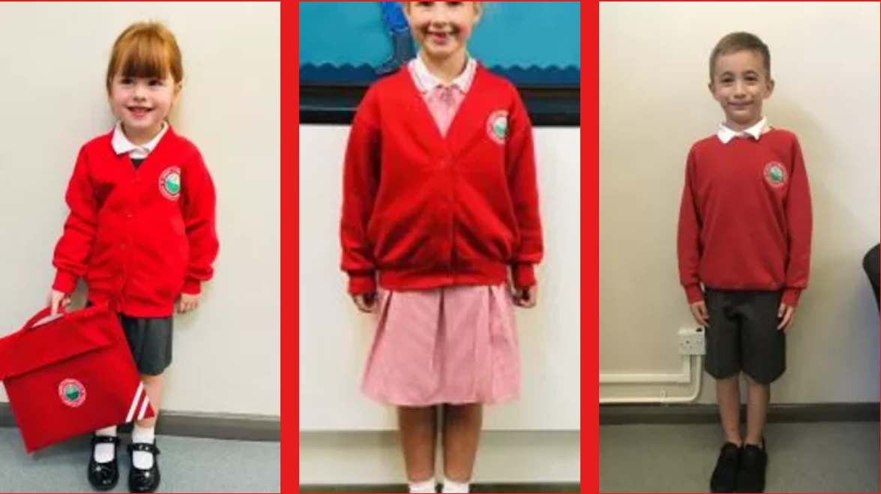
Uniform
Link to uniform on our school website:
https://www.langafel.kent.sch.uk/school-uniform
If your child does not have the correct school uniform, teachers will ask you when this will be provided and a more suitable school alternative may be given.

Slide 10
Food and Drink
Water in school - Children can bring in a water bottle to keep in the classroom; there is also access to a water fountain on the playground/drinking water to fill up bottles.
Playtime snacks - A snack of fruit or plain biscuits can be brought in for morning play time – fruit is also provided to all children in KS1.
School Dinners - If your child requires a school dinner, this must be ordered and paid for in advance on CH&Co. Every child in KS1 is entitled to free school meals.
Packed Lunches - At Langafel we are committed to encouraging our pupils’ to eat healthily and make sensible food choices.
We encourage children to have a nutritious and balanced packed lunch – crisps and chocolate are allowed but in moderation and in addition to fruit and healthy options.
No nut products; this includes chocolate spreads which may include nuts.

Slide 11
General Reminders
All required stationery is provided so pupils should not bring anything from home.
- This includes toys and pencil cases.
Children need to have a good nights sleep, a healthy breakfast and be ready, willing and motivated to learn throughout the day.
They should be respectful to everyone they come in contact with, adults and children alike.
First Aid
Inhalers are to be given to the class teacher at the beginning of the year, these will be stored with your child’s details.

Slide 12
Parents in Partnership with School
Have a skill we could use? A job related to one of our topics? Talk to us!
Ways to keep in touch:
Message to adults on the gate in morning – these are all passed on to your child’s class teacher.
Brief chat at gate after school (teachers are busy getting children into cars so if you need a longer chat, please arrange a more convenient time with your child’s class teacher)
Email to book appointment: email addresses:
wellis@langafel.kent.sch.uk – Mrs Ellis (Tiger)
cwatkins@langafel.kent.sch.uk – Mrs Watkins (Koala)
Jkeene@Langafel.kent.sch.uk Mrs Keene (Koala)
jgraham@langafel.kent.sch.uk – Mr Graham (Wolf)
If you do not receive school emails, please visit the office to check they have your correct/updated contact details.

Slide 13
Questions?

