Slide 1
Meet the Teachers LKS2
2022-2023

Slide 2
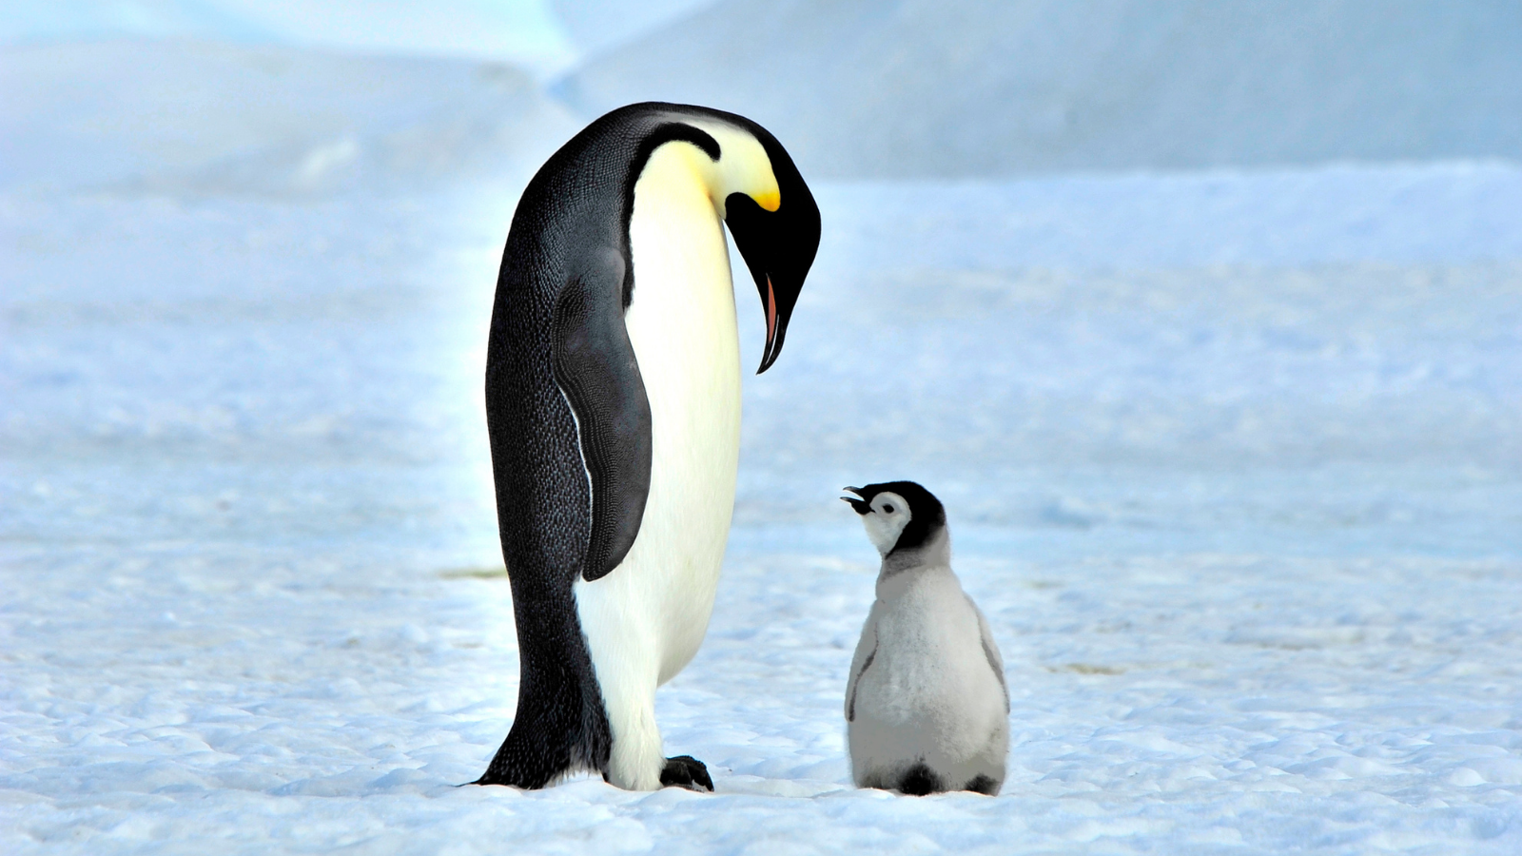
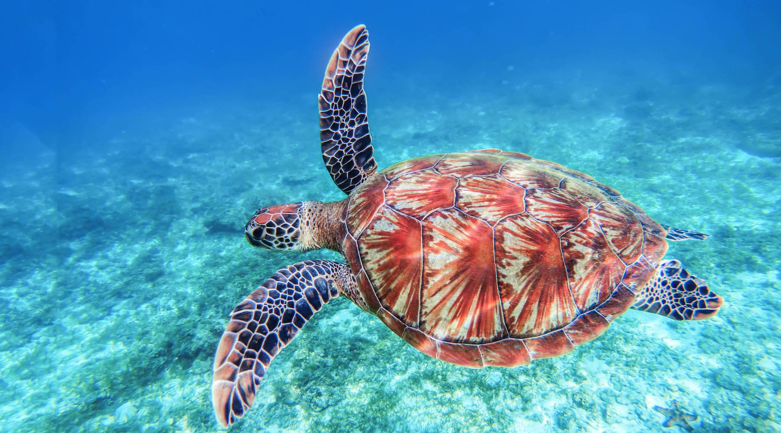
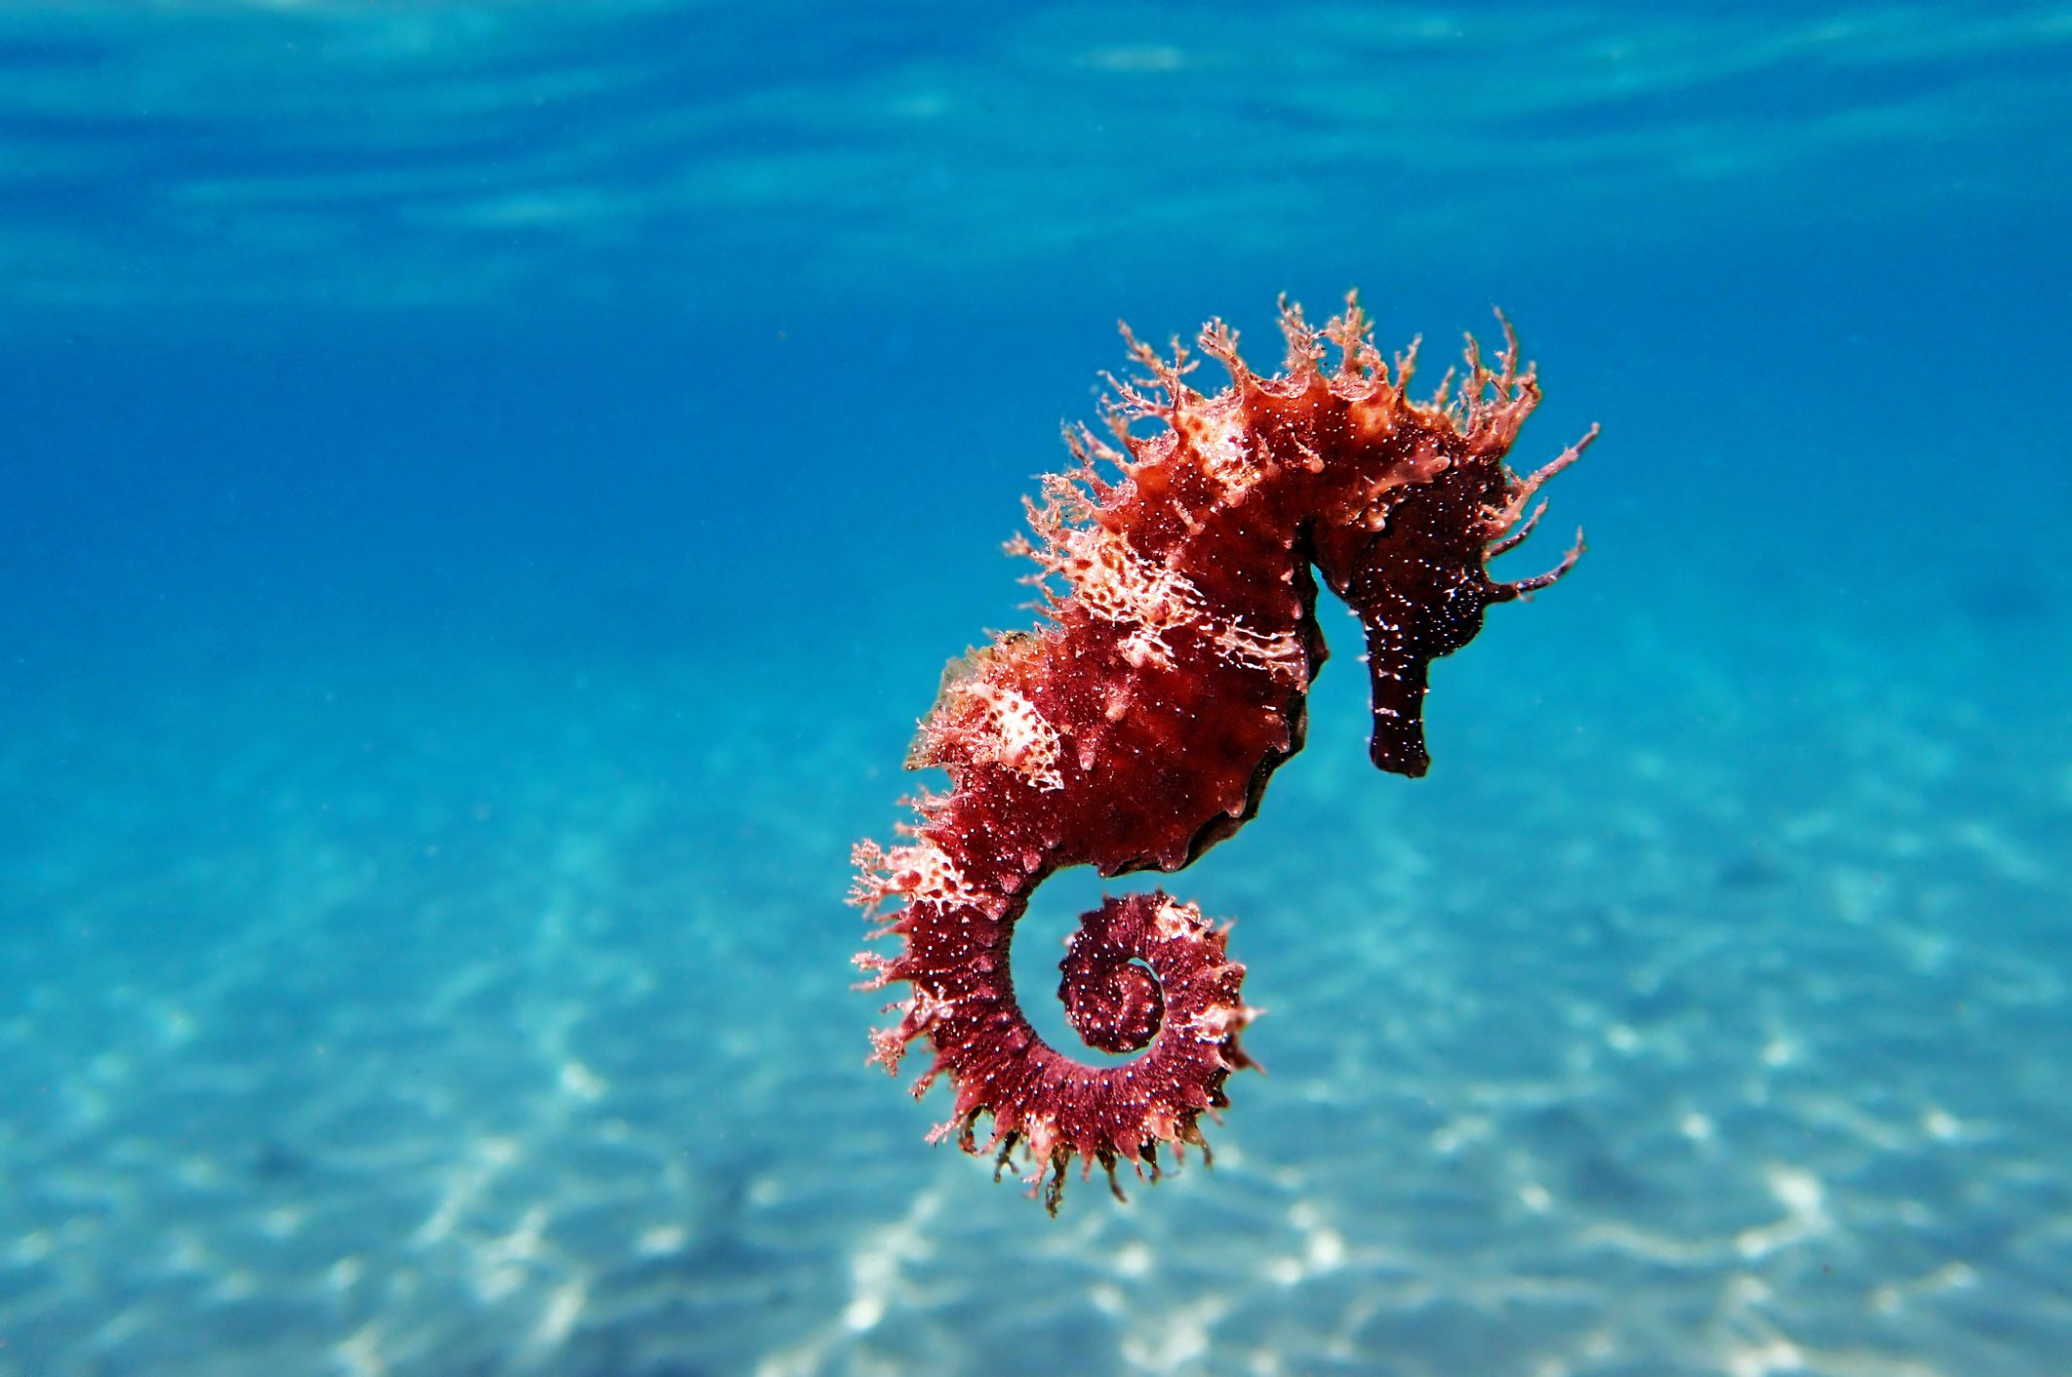
Who’s who in Year 3/4?
 | Penguin Class | Turtle class | Seahorse Class
Teachers: | Mrs Hemple | Miss Ragon and Miss Carter | Mrs Kay
Teaching Assistants: | Mrs Sawyer | Mrs Mulla and Mrs Holmes | Mrs Duffin and Miss Yates
Cover teacher: | Mrs Lawrence

Slide 3
Classrooms and Entering/Exiting School
Arrive between 8:30-8:45am – Use the drive-in system to drop your child off in the back playground or walk in by foot. Children come into school via the Year R outdoor area (next to Molly’s)
School ends at 3pm – Please avoid arriving early as this can cause traffic on Gorsewood Road.
Collect your child from the same gate as morning drop off by foot or by using the drive-in system to collect your child in the same way as KS1.
If you are running particularly late, please inform the office. The pick up window is 3-3:15pm.
Children attending after school club are sent directly there from their classroom at the end of the day.
Children attending teacher-led clubs are sent to the location of the club/the classroom of the teacher running the club.

Slide 4
A Typical Day in Year 3/4
Time | Session
8:30am – 8:55am | EMW and registration
9am – 10am | English
10am – 10:30am | SPAG/Phonics and guided reading
10:30am – 10:50am | Worship
10:50am – 11:05am | Break
11:05am – 12:05pm | Maths
12:05pm – 1:05pm | Lunch
1:05pm – 2pm 2pm – 2:55pm | Two sessions: Topic, PE, Science, RE, Computing, French, RSHE
3pm | Home time
Children that still require phonics learning will do this along with appropriate guided reading instead of SPAG until they are ready.
Year groups are split for maths – two Year 3 classes and two Year 4 classes

Slide 5
Other curriculum areas
The Year 3/4 curriculum map which shows the national curriculum progression throughout the year will be available on the school website from September.
https://www.langafel.kent.sch.uk/academics
Knowledge Organisers for every new topic can be found on the school website and a paper copy will be provided.
https://www.langafel.kent.sch.uk/blank-page-8

Slide 6
Curriculum map
 | Topic with weblinks | Events/visits planned
Term 1 | Through the Ages | Kent Life Stone Age workshop
Term 2 | Egyptians | Dress up like an Egyptian – theme day in school
Term 3 | Ancient Greece | TBC
Term 4 | Ancient Greece
Term 5 | Extreme Earth | TBC
Term 6 | Extreme Earth

Slide 7
Core curriculum: Reading in LKS2
Home Reading Books
In September, we will be introducing Accelerated Reader across Year 3 and 4.
Once your child has finished their book, they will complete an online quiz on it the following day at school. Following this, they will change their book. Children will be assessed 3-4 times a year which will indicate when children are ready to move up a band – this will be communicated through their reading contact book.
Hearing your child read is the most valuable thing you can do – 10 minutes of daily reading can make a huge difference!
Ensure you ask questions – it is not just about fluency, comprehension and understanding is important!

Slide 8
Core curriculum: Reading in LKS2
READING | Year 3 and Year 4
How are reading books organised and changed? | Children hand in their reading book and contact book every day which is checked daily. Most children will access a reading book from the Accelerated Reader levelling system, however, if you child still requires phonics, they will continue on the Little Wandle (Collins Big Cat) level books.
How is reading taught in school? | Little Wandle Phonics Programme for those still requiring phonics Daily guided reading sessions Daily independent reading and class story time
Expectation for reading to an adult at home. | Children are expected to read at least three times a week to an adult at home which is logged in their contact book.
What else can I do to support my child? | Reading to your child/sharing a book for pleasure and talking about what has happened/is happening in the book; make predictions; discuss what they liked/disliked and why etc. Audio books Expose them to a range of texts – fiction as well as non-fiction.

Slide 9
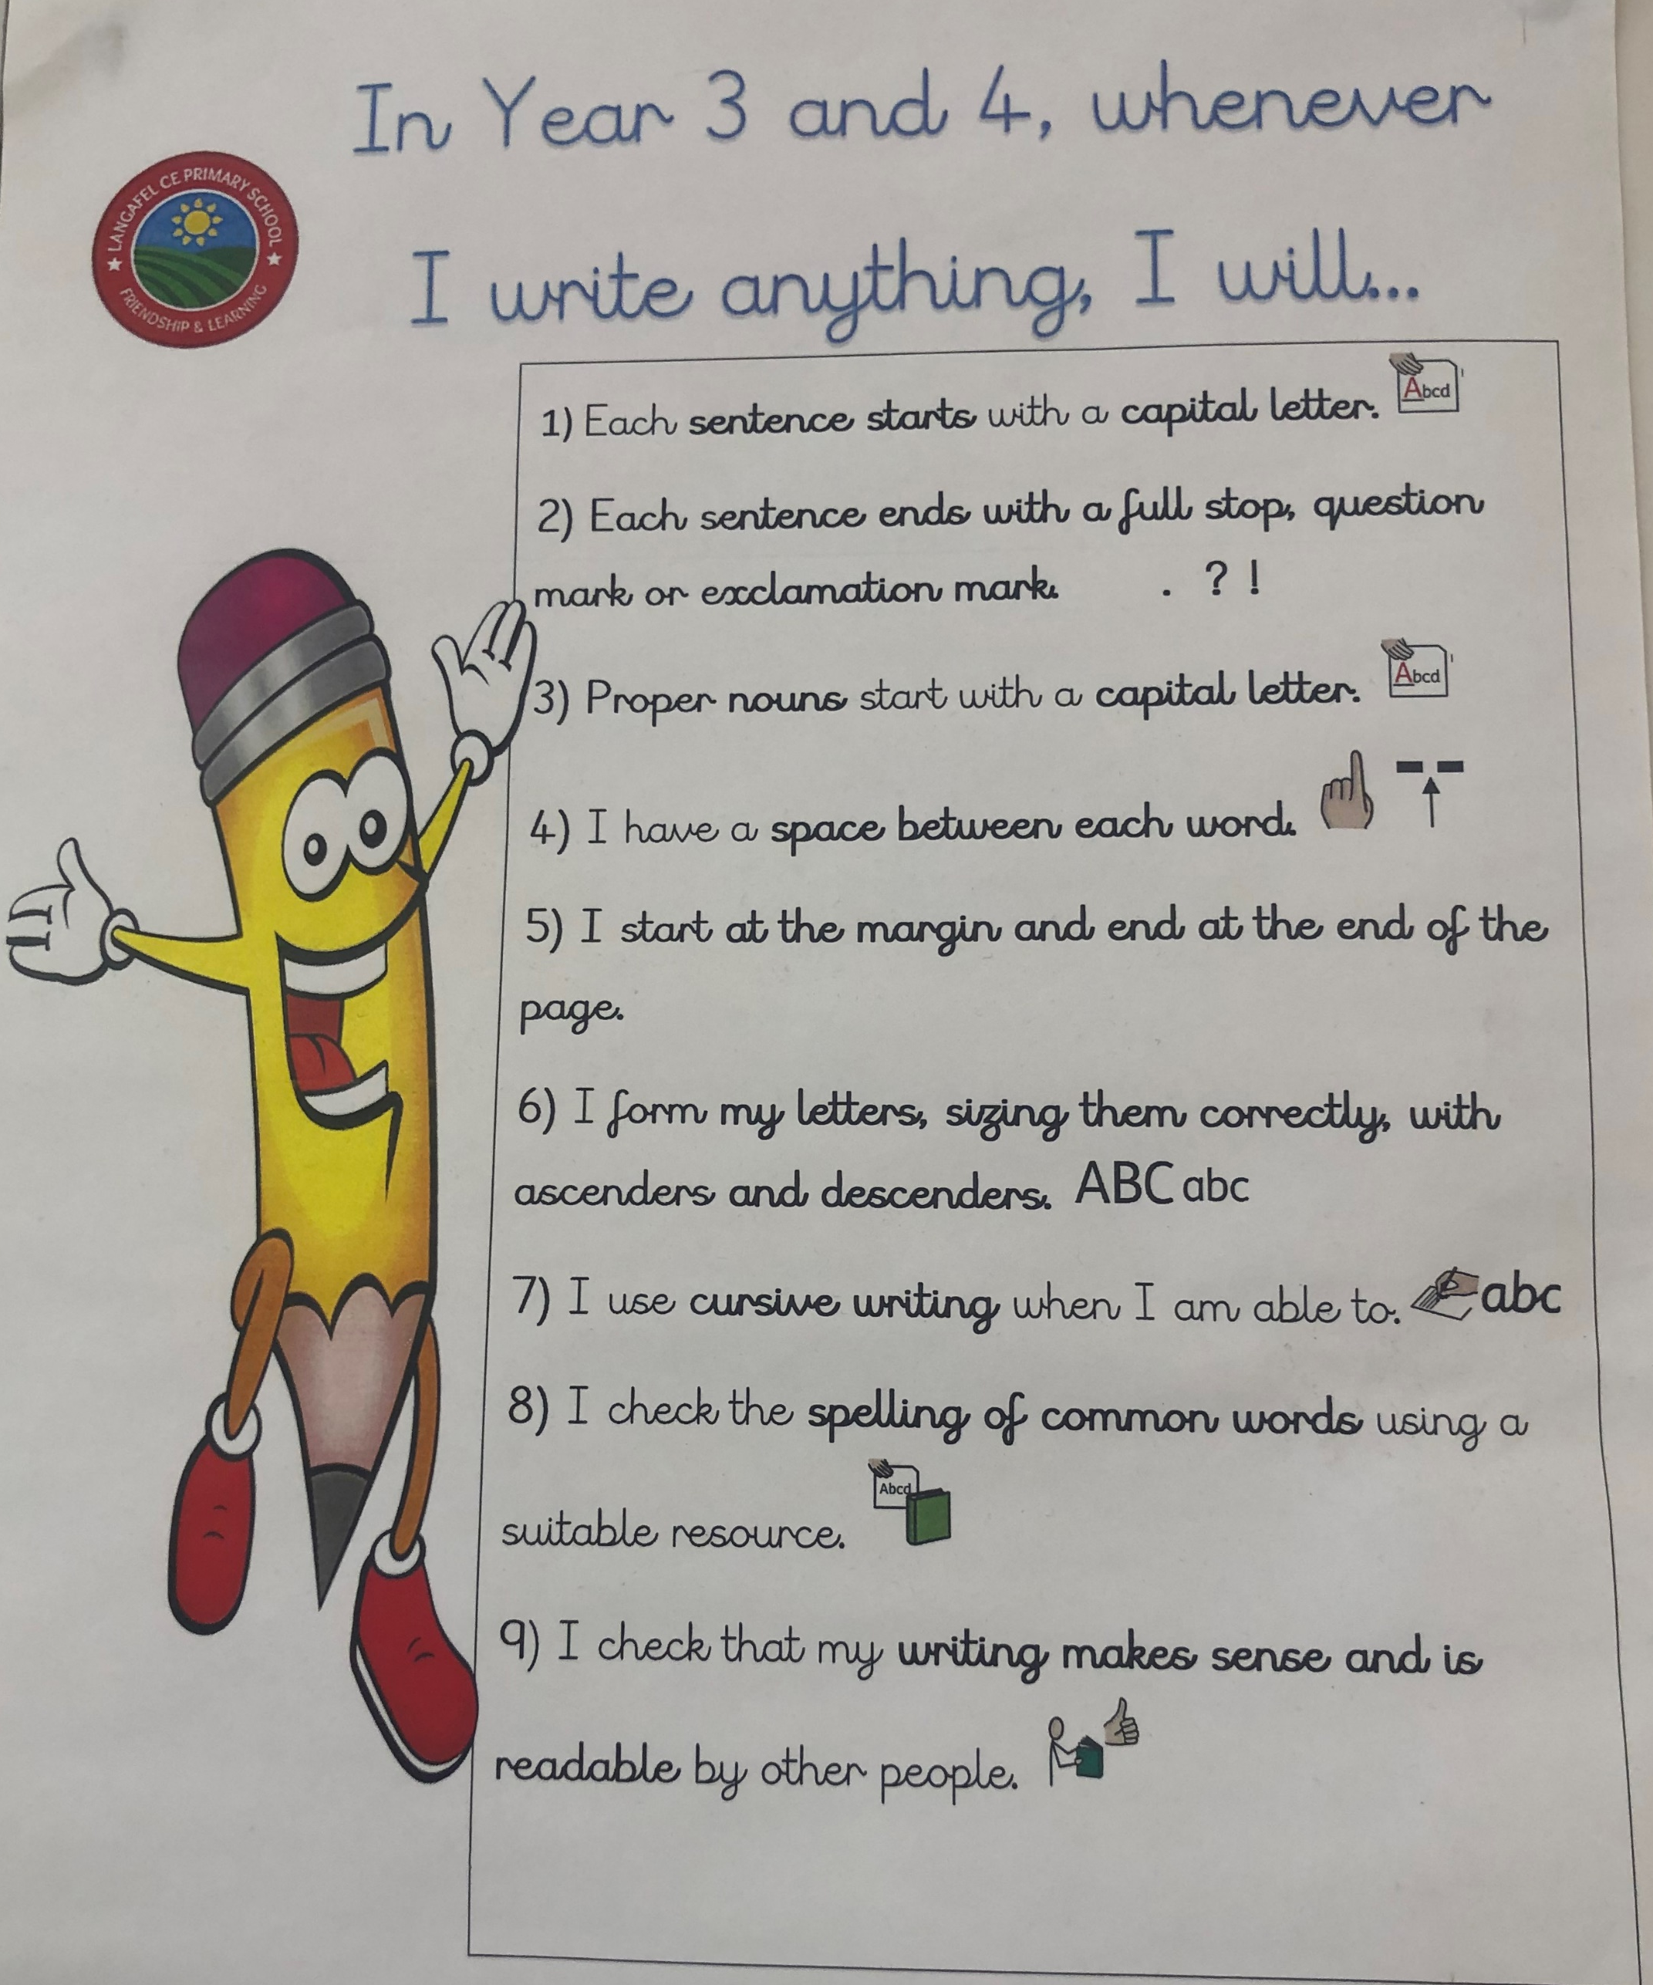
Core curriculum: Writing in LKS2
How is writing taught in school? | The non-negotiables in Year 3/4
We use The Write Stuff scheme and select books from this which fit in with our termly topics. The Write Stuff incorporates grammar, punctuation and spelling into writing lessons and teaches children how to form different genres of writing whilst including their specific features.
Capital letters and correct punctuation in sentences.
Capital letters for proper nouns.
Space between every word.
Starting at the margin and writing across the page.
Letter formation is correction for lower and uppercase letters.
Cursive writing is used.
Spelling of common words is checked and correct.
Checking your writing makes sense.

Slide 10
Core curriculum: Writing in LKS2
HANDWRITING | Year 3 and Year 4
All Year 3 and 4 children are expected to do joined up writing – this is part of the expected standard. | There will be a big focus on handwriting at the start of the year to improve joined up writing as well as size/proportions. Descenders must go under the line (f g j p q y)

Slide 11
Core curriculum: Maths in LKS2
Maths | Year 3 | Year 4
Teaching of maths | Two mixed ability year group class.
Times Tables | Children will know the 2, 3, 5 and 10 times tables from Year 2. In Year 3, they will learn the 4, 8 and 11 times tables and how to count in multiples of 50 and 100. | Continue to revise the 2, 3, 4, 5, 8 and 10 times tables. In Year 4, children will learn the 6, 7, 9 and 12 times tables and how to count in multiples of 25 and 1000.
 | Times Table Rockstars will be rolled out across the phase.
Key facts that they need to know | Recognise the place value of each digit in a three-digit number (hundreds, tens, ones) Compare and order numbers up to 1000 Addition and subtraction up to three digits using the column method | Count backwards through zero to include negative numbers Recognise the place value of each digit in a four-digit number (thousands, hundreds, tens, and ones) Order and compare numbers beyond 1000 Round any number to the nearest 10, 100 or 1000 Addition and subtraction up to four digits using the column method

Slide 12
Other significant dates/events
Year 4 Multiplication Test
All Year 4 children complete the test
The test takes place during term 6 (beginning/mid June)
The test’s purpose is to see if children can fluently recall tables up to 12.
What the test involves:
Judges children’s ability to recall 25 times table facts.
They are given 6 seconds to answer each question (the test should take no longer than 5 minutes)
For more information on the multiplication tables check: https://www.gov.uk/government/publications/multiplication-tables-check-information-for-parents/multiplication-tables-check-information-for-parents-text-version--2

Slide 13
Year 4 Multiplication Tables Check info
Supporting your child:
Regular times tables practise!
For more information on the multiplication tables check: https://www.gov.uk/government/publications/multiplication-tables-check-information-for-parents/multiplication-tables-check-information-for-parents-text-version--2

Slide 14
PE
 | Tiger, Wolf and Koala
PE | All classes will have another PE session during the week – days to be confirmed at the start of Term 1.
Swimming | Each class will swim on a different day of the week in term 1, 5 and 6. (Info on next slide)
Mandatory PE kit:
Black plimsolls/sensible trainers
Plain black shorts
T-shirt in house colour – house colour PE tops with the school logo on are available to purchase on the uniform website or a plain shop brought one is acceptable; this means no logos or brands written across the t-shirt.
PE is not a fashion show - own clothes and football kits are not PE clothing.
If your child wears clothes that are not within the PE kit uniform policy, you will be phoned and asked to bring in appropriate PE clothing.
All jewellery removed – children have to remove their own earrings (no tape allowed)
Optional Extras • Plain black tracksuit (optional for outdoor PE sessions in cold weather) • Plain black zip-up jacket

Slide 15
Swimming in Yr 3/4
Year 3 and 4 swim in Term 1, 5 and 6 – we are hoping this will commence in term 1, however, we are currently investigating a leak so this will be confirmed by September.
Each class will swim on a different day. This counts as one of their weekly PE sessions in term 1, 5 and 6. The class are split into two groups based on their ability/confidence in the water. This means roughly 15 children are swimming at one time.
Lessons are taught by an outside agency who are supported by our own staff.
If children are unable to swim due to illness they will require a note from home.
Swimming kit:
• Swimming costume/trunks (no bikinis allowed)
Towel
Swimming cap – children with hair shoulder length or longer must have it tied up with a cap on)
All jewellery removed – children have to remove their own earrings
Goggles are optional

Slide 16
Homework expectations in LKS2
Year 3 and Year 4
Daily reading (at least three times a week) Weekly homework – handed out on a Friday and due the following Wednesday – this will be either maths or SPAG (spelling, punctuation and grammar) activities linked to learning from the week. Topic curriculum homework – a selection of suggested activities related to the term’s topic will be in homework books at the beginning of a new topic. The topic curriculum homework tasks are optional to complete but they will be a great opportunity for you to engage with your child and their learning around our current topic. Children will be given the opportunity to share any topic homework they complete with their peers. All children will receive accessibility to Times Table Rockstars from home.
Rewards for homework House points will be given out for all completed homework.

Slide 17
Behaviour management – the positives!
Golden Book
Every week, a child in every class will receive the Golden Book Award in worship for something that has made them stand out, their efforts during a particular task or an individual achievement for the child.
Class marble jar
Each class will have a marble jar – they will earn marbles as a class for good behaviour, listening, working well etc. Once full, the class will get to decide on a class treat – extra green time, extra time outside etc.
House points
Each child will have their own house point tally. House points are given out for great work, manners, being helpful, participation etc. Children will receive a badge when they reach certain marks:
Bronze badge – 50 house points Silver badge – 75 house points
Gold badge- 100 house points Every 50 house points after 100 – prize from the class box (another prize will be given for every 25 house points after this)

Slide 18
Behaviour management
We follow the Good to be Green system
All children start on a green card. For inappropriate behaviour that does not adhere to the class charter, children will go through the following procedure:
First act of behaviour – receive a verbal warning
Second incident – receive a yellow card – spend 10 minutes in the Reflection Room at break/lunch
Continuous behaviour/another incident – receive a red card – spend 15 minutes in the Reflection Room and incidence are documented on the school’s system.
Once they have been to the reflection room, their card will go back to green.
Depending on the severity of the incident, children can go straight to a red card without warning (example: maliciously hurting another child/adult, bad language, destruction to school equipment).
If bad behaviour continues/red cards are frequent, parents/guardians will be informed.
Our behaviour policy is updated yearly and can be found on the school website.

Slide 19
Attendance
Attendance is vital for children to learn. Missing learning can create gaps which a child struggles to fill. This can cause problems later on as learning builds.
Good attendance is anything above 96% (this equates 8 days of absence across a school year).
If absence is below 90% (20 days absence across the year) then your child is deemed to be persistently absent from education.
If your child is sick please contact the office with a reason on the 1st day of absence from 8:30am.
Attendance rewards
10 Days – Every day the whole class have 100% attendance, they progress towards the 10 goal. When they achieve 10 days of 100% attendance extra green time is given.

Slide 20
Uniform
Standard uniform
White polo, blouse or shirt
Grey trousers, shorts, skirt or pinafore
Red gingham summer dresses
Red jumper/cardigan with the school logo
Flat black shoes – no trainers
Plain black, grey or white ankle or knee length socks
Plain black, grey or red tights
Hair accessories – red, black or white and appropriate size
Hair longer than collar length should be tied back.
No make-up or nail vanish
No jewellery with the exception of 1 pair of small plain studded earrings, a small watch (not novelty) and jewellery worn specifically for religious reasons.

Slide 21
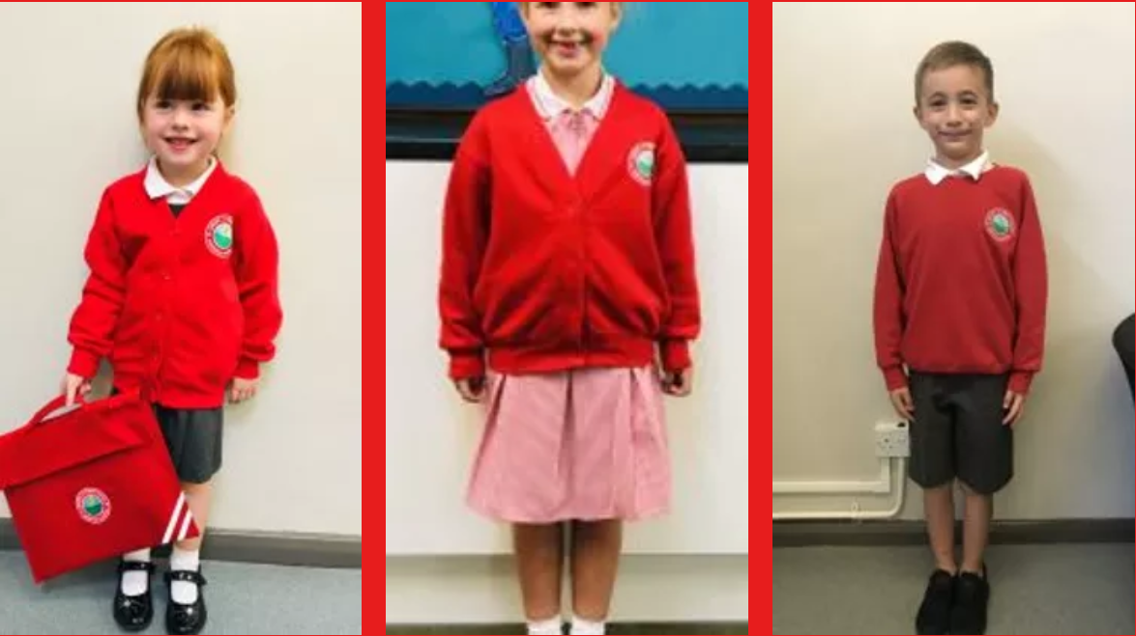
Uniform
Link to uniform on our school website:
https://www.langafel.kent.sch.uk/school-uniform
If your child does not have the correct school uniform, teachers will ask you when this will be provided and a more suitable school alternative may be given.

Slide 22
Food and Drink
Water in school - Children can bring in a water bottle to keep in the classroom; there is also access to a water fountain on the playground/drinking water to fill up bottles.
Playtime snacks - A snack of fruit or plain biscuits can be brought in for morning play time – fruit is no longer provided in KS2.
School Dinners - If your child requires a school dinner, this must be ordered and paid for in advance on CH&Co. School dinners are no longer free in KS2.
Packed Lunches - At Langafel we are committed to encouraging our pupils’ to eat healthily and make sensible food choices.
We encourage children to have a nutritious and balanced packed lunch – crisps and chocolate are allowed but in moderation and in addition to fruit and a healthy options.
No nut products; this includes chocolate spreads which may include nuts.

Slide 23
General Reminders
All required stationery is provided so pupils should not bring anything from home.
- This includes toys/fidgets, pencil cases, gel pens etc.
Pencil cases will be allowed on a Friday during Green Time or at the teacher’s discretion.
They need to have a good nights sleep, a healthy breakfast and be ready, willing and motivated to learn throughout the day.
They should be respectful to everyone they come in contact with, adults and children alike.
First Aid
Inhalers are to be given to the class teacher at the beginning of the year, these will be stored with your child’s details.
Unless there is a specific medical need which teachers have been informed of, pupils should not be going to the toilet during learning time and are encouraged to use the opportunity at break and lunch.

Slide 24
Parents in Partnership with School
Have a skill we could use? A job related to one of our topics? Talk to us!
Ways to keep in touch:
Message to adults on the gate in morning – these are all passed on to your child’s class teacher.
Brief chat at gate after school (teachers are busy getting children into cars so if you need a longer chat, please arrange a more convenient time with your child’s class teacher)
Email to book appointment: email addresses:
lhemple@langafel.kent.sch.uk – Mrs Hemple (Phase Leader and Tiger)
aragon@langafel.kent.sch.uk – Miss Ragon (Wolf)
scarter@langafel.kent.sch.uk – Miss Carter (Wolf)
skay@langafel.kent.sch.uk – Mrs Kay (Koala)
If you do not receive school emails, please visit the office to check they have your correct/updated contact details.

Slide 25
Thank you for listening! Any questions?

